Slide 1
House Hunters!!
Machine Learning Housing Data Analysis
Bhargav Andipara
Bhoomika Patel
Jake Menchak
Sudarshan Mahanubhav

Slide 2
California Housing Dataset
Derived from the 1990 U.S. census, using one row per census block group
Samples: 20,640
Attributes: 8 numeric, predictive attributes
Target Variable: Median house value for California districts
Original Purpose: Spatial statistics using distance matrix
Authors’ R2 score = 0.8594
Reference:
Pace, R. Kelley and Ronald Barry, Sparse Spatial Autoregressions, Statistics and Probability Letters, 33 (1997) 291-297
This dataset was obtained from the StatLib repository. http://lib.stat.cmu.edu/datasets/

Slide 3
Features
MedInc (Median income for households within a block of houses)
HouseAge (Median age of a house within a block; a lower number is a newer building)
AveRooms (Average number of rooms within a block)
AveBedrms (Average number of bedrooms within a block)
Population (Total number of people residing within a block)
AveOccup (average house occupancy in block)
Latitude (A measure of how far north a house is; a higher value is farther north)
Longitude (A measure of how far west a house is; a higher value is farther west)

Slide 4
Project Requirements
Python Scikit-Learn
Python Pandas
Python Matplotlib
Tableau

Slide 5
EXPLORATORY DATA ANALYSIS

Slide 6
Exploratory Data Analysis Steps
Review summary statistics
Plot histograms of all features
Plot Latitude, Longitude to visualize Target and Population
Create correlation matrix of all variables
Plot heatmap of correlation matrix of all variables
Check correlation of all features relative to Target variable
Plot scatter matrix of all variables
Create scatter plot of all features relative to Target variable

Slide 7
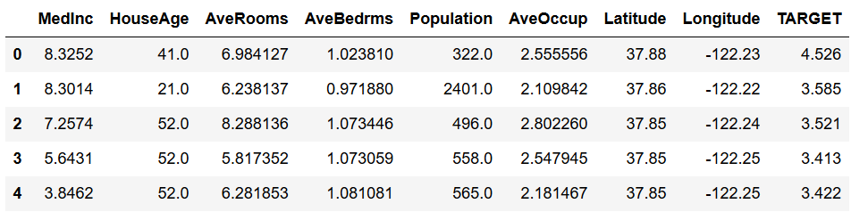
Header
MedInc measured in tens of thousands of US Dollars
TARGET (Median house value) measured in hundreds of thousands of US Dollars

Slide 8
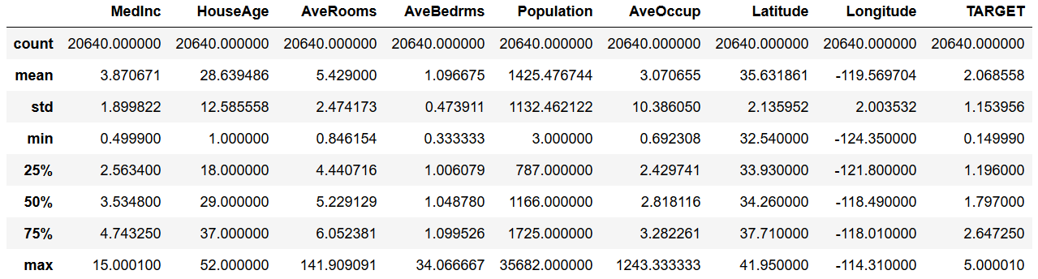
Summary Statistics
No missing values
There’s a lot of variation in the data

Slide 9
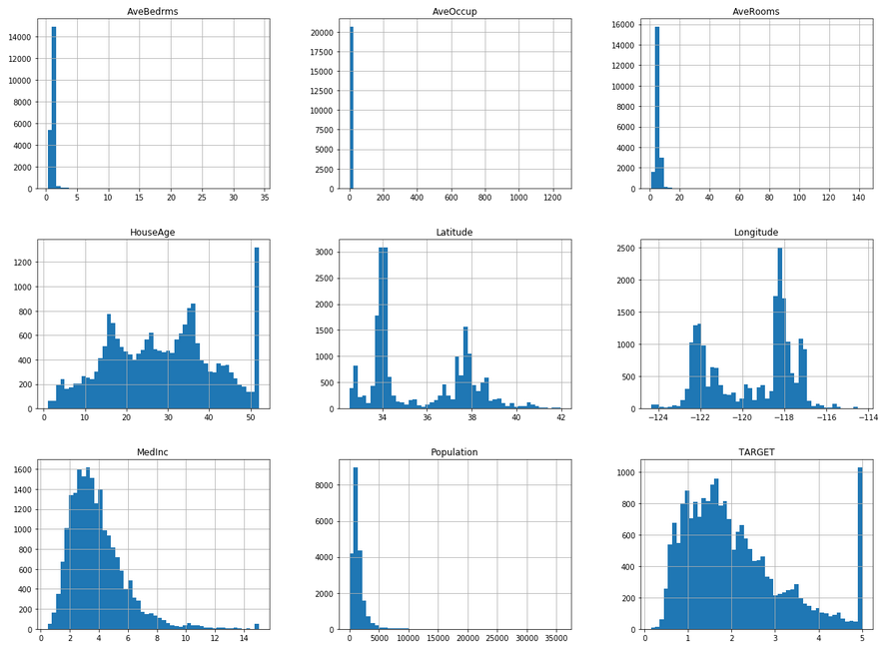
Feature Histograms
Features are not normally distributed

Slide 10
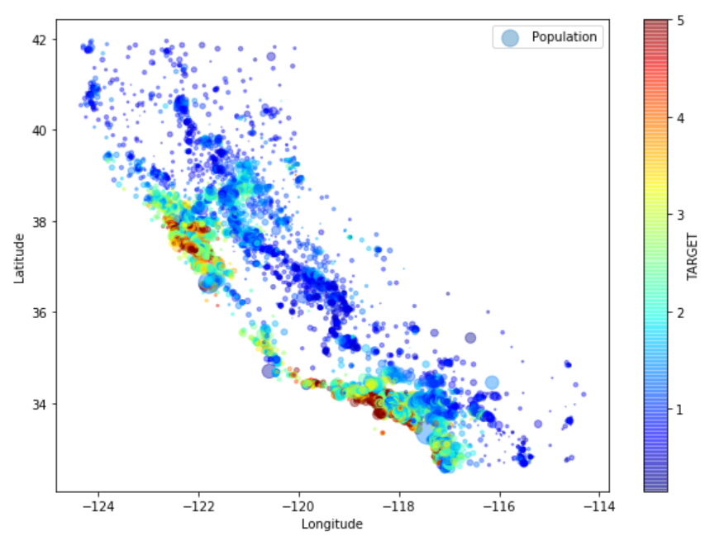
Visualizing Price
Houses closer to the shore have higher value

Slide 11
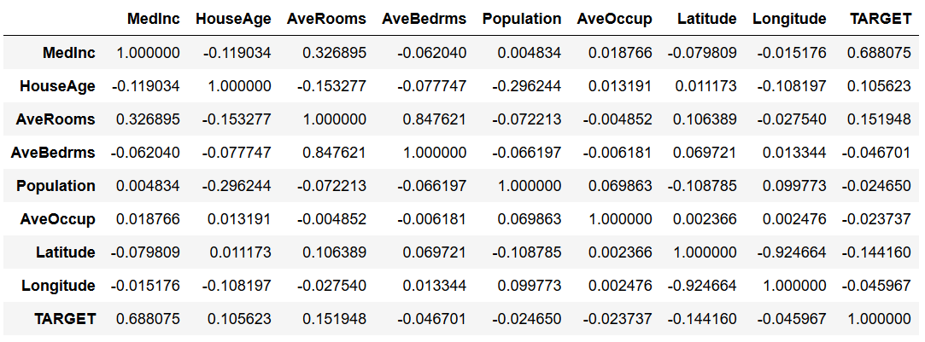
Correlation Matrix
MedInc, AveRooms, and HouseAge are most correlated with the Target

Slide 12
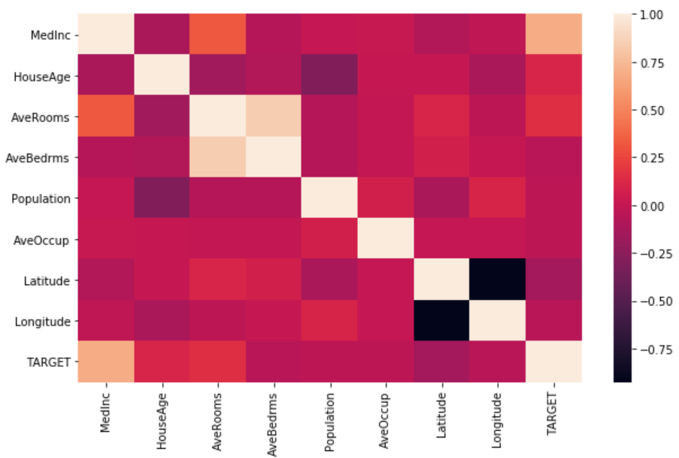
Correlation Matrix Heatmap
MedInc, AveRooms, and HouseAge are most correlated with the Target

Slide 13
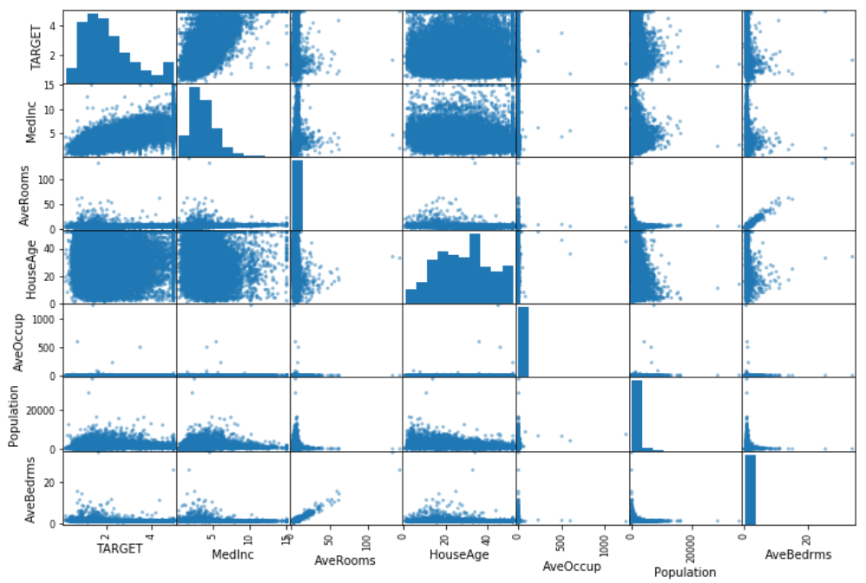
Scatter Matrix
AveRooms, and AveBedrms are highly correlated with each other

Slide 14
Feature Correlations
MedInc 0.688075
AveRooms 0.151948
HouseAge 0.105623
AveOccup -0.023737
Population -0.024650
Longitude -0.045967
AveBedrms -0.046701
Latitude -0.144160

Slide 15
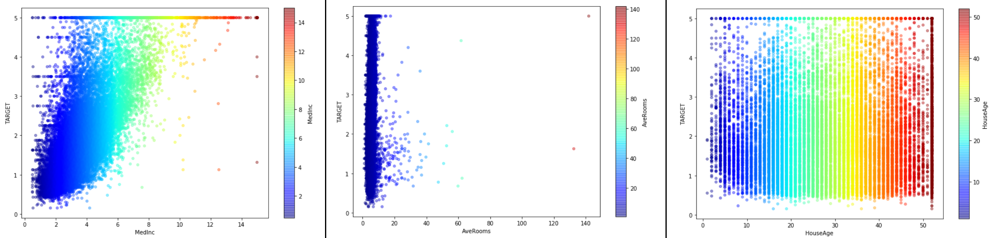
Scatter Plot of Top Features
Top features don’t show a clear pattern, so feature engineering will be required

Slide 16
MODELING

Slide 17
Modeling Steps (Stage 1)
Create training and test sets
Evaluate performance of various regression models
Evaluate linear regression with regularization (Lasso, and Ridge)
Evaluate scores of various regression models

Slide 18
Modeling Steps (Stage 2)
Create new features and perform data transformation
Perform exploratory data analysis of the new features
Check correlation of all features relative to Target variable
Create training and test sets
Evaluate scores of GradientBoostingRegressor models with different n_estimators
Perform model selection using GridSearchCV to pick the best parameters for GradientBoostingRegressor
View model selection results
Evaluate the final model using test set
Save final model as a pickle/joblib file and evaluate the saved files using test set

Slide 19
Evaluating Multiple Regressors (Performance)
Regressor | Training Time/ Fit Time | Prediction Time/ Scoring Time | R2 Score
LinearRegression | 0.006s | 0.002s | 0.5929
RANSACRegressor | 0.123s | 0.000s | 0.2189
KNeighborsRegressor | 0.052s | 0.024s | 0.1327
KNeighborsRegressor(n_neighbors=9, metric='manhattan') | 0.042s | 0.045s | 0.2346
SVR | 6.699s | 1.111s | -0.0108
LinearSVR | 0.958s | 0.000s | 0.3178
GaussianProcessRegressor | 89.857s | 6.206s | -2.7944
SVR(kernel='linear') | 4700.713s (78.34 min) | 0.517s | 0.5174

Slide 20
Evaluating Multiple Regressors (Metrics)
Regressor | Explained Variance | Mean Absolute Error | R2 Score
LinearRegression | 0.5932 | 0.5351 | 0.5929
DecisionTreeRegressor(max_depth=5) | 0.6141 | 0.5179 | 0.6140
DecisionTreeRegressor(max_depth=10) | 0.6951 | 0.4172 | 0.6950
DecisionTreeRegressor(max_depth=20) | 0.6010 | 0.4583 | 0.6008
RandomForestRegressor(max_depth=10) | 0.7705 | 0.3663 | 0.7705
GradientBoostingRegressor (n_estimators=200) | 0.7989 | 0.3494 | 0.7989
GradientBoostingRegressor (n_estimators=850) | 0.8506 | 0.3041 | 0.8506
GradientBoostingRegressor (n_estimators=1000) | 0.8515 | 0.3027 | 0.8514

Slide 21
Feature Engineering (New Features)
ZipCode (located using Latitude & Longitude and Google Maps API)
Household (Population/AveOccup): Total number of households, a group of people residing within a home unit, for a block
TotalRooms (Household/AveRooms): Total number of rooms within a block
TotalBedrms (Household/AveBedrms): Total number of bedrooms within a block
TR_Pop (TotalRooms/Population): Proxy for population density in a block
BR_Pop (TotalBedrms/Population)

Slide 22
Feature Engineering (Data Transformation)
Applied the following data transformations to MedInc, HouseAge, AveRooms, AveBedrms, Population, AveOccup, Households, TotalRooms, TotalBedrms, TR_Pop, and BR_Pop
Bins (11 bins, 0 to 100, based on percentile distribution of the column)
SQRT (square root of each value)
LN (natural log of each value)
Discarded square, cube, and log10

Slide 23
Feature Engineering (New ZipCode Feature)
Reverse Geocoding:
ZIP codes acquired from Google Maps API
House location coordinate pair: latitude + longitude
Coordinate pairs passed to the API
API returns full street address (including ZIP code)
Format: street, city, county, state, ZIP code, country
I.e.: South Pebble Beach Drive, Crescent City, Del Norte County, California, 75531, USA
Source: -124.23, 41.75
Notes:
Python's zip() function is defined as zip(*iterables) . The function takes in iterables as arguments and returns an iterator. This iterator generates a series of tuples containing elements from each iterable. zip() can accept any type of iterable, such as files, lists, tuples, dictionaries, sets, and so on.
Python zip() The zip() function returns an iterator of tuples based on the iterable objects. ... If multiple iterables are passed, zip() returns an iterator of tuples with each tuple having elements from all the iterables.

Slide 24
Feature Engineering (New ZipCode Feature)
Data Cleaning:
Pulled out ZIP codes from full street addresses
Address dataset has 5-digit, 9-digit, and “no ZIP code” addresses
Some remote areas do not have a ZIP code
Checked if an approximate ZIP code exists
Housing dataset latitude and longitude limited accuracy
i.e. -124.23, 41.75
Actual house location within radius of ~1,000 meters
Used approximated ZIP codes (where available)

Slide 25
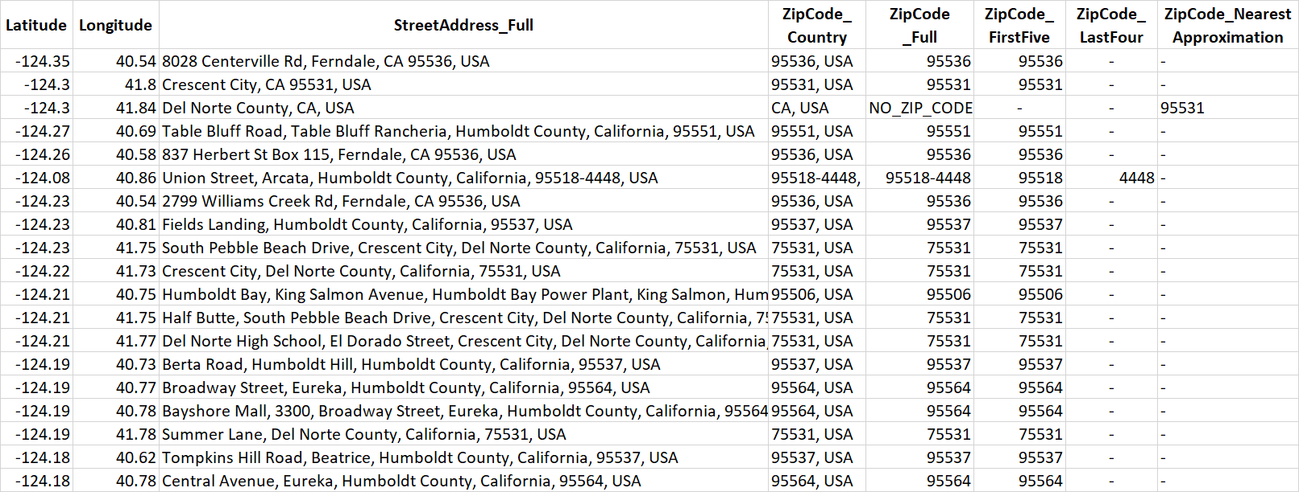
Feature Engineering (New ZipCode Feature)

Slide 26
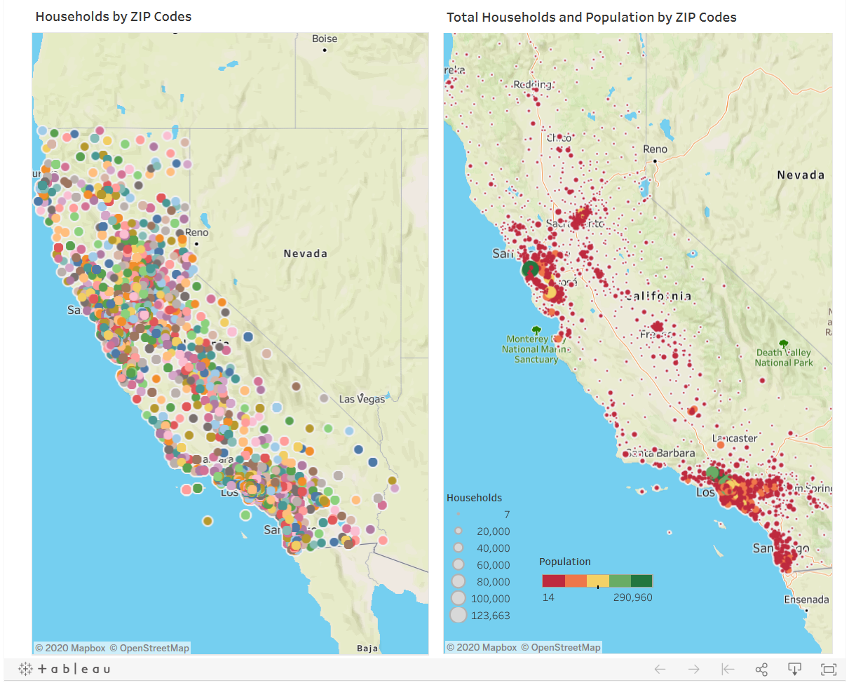
Visualizing Households
https://public.tableau.com/profile/bhoomika.patel#!/vizhome/california_housing/Dashboard1

Slide 27
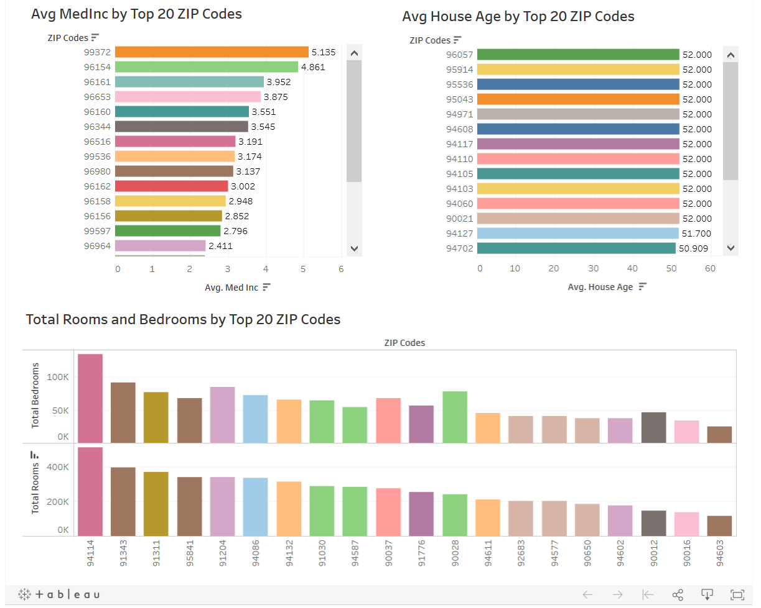
Visualizing Top 20 ZIP Codes
https://public.tableau.com/profile/bhoomika.patel#!/vizhome/california_housing/Dashboard1

Slide 28
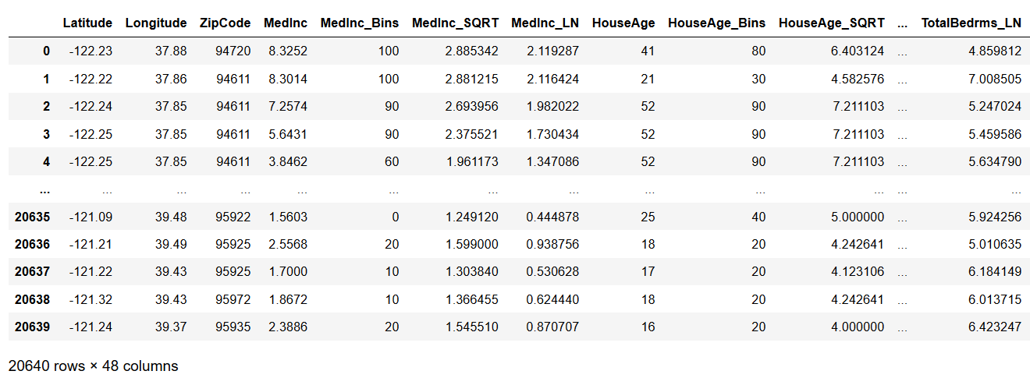
Header (Stage 2)
Added 39 new features

Slide 29
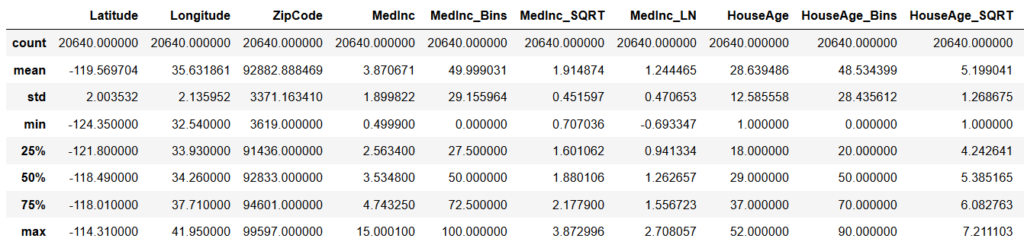
Summary Statistics (Stage 2)

Slide 30
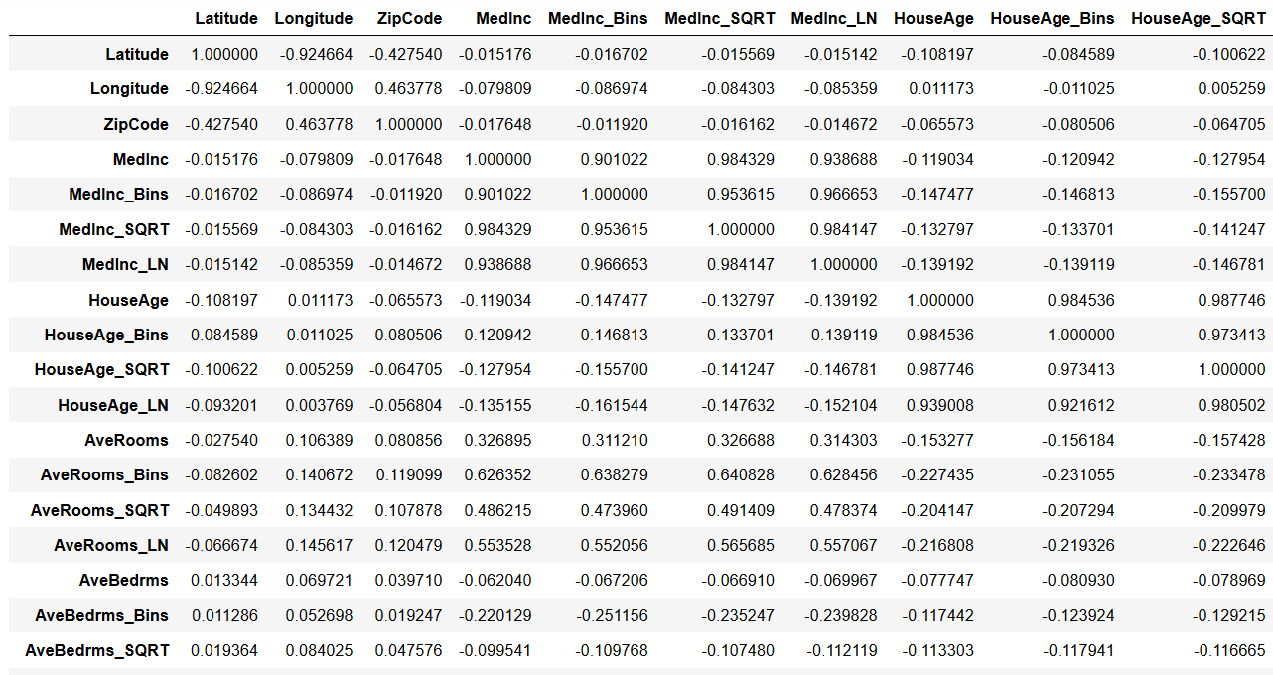
Correlation Matrix (Stage 2)

Slide 31
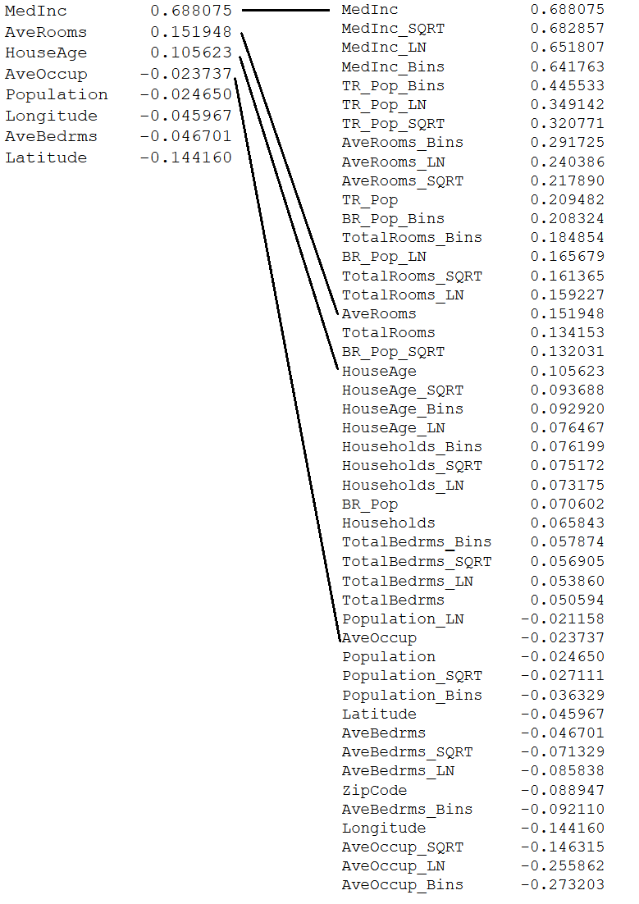
Feature Correlations

Slide 32
15 new features

Slide 33
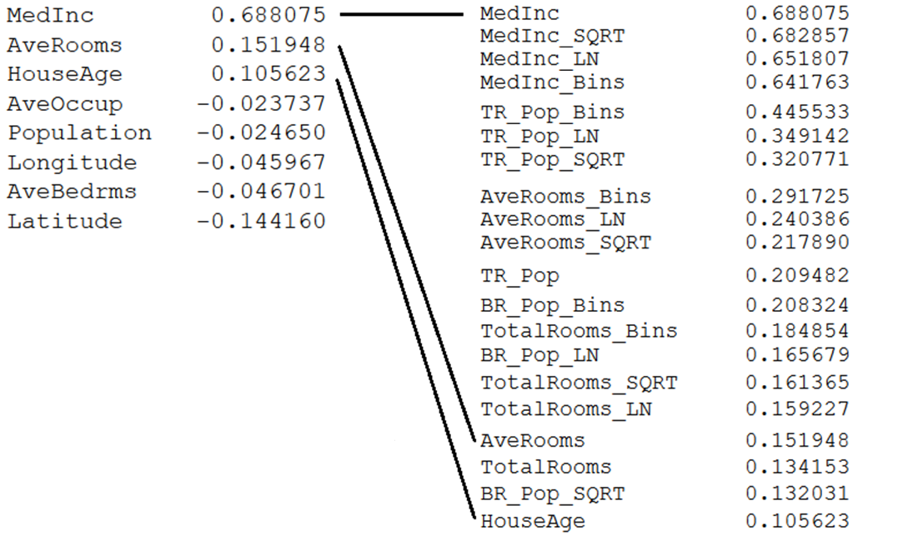

Slide 34
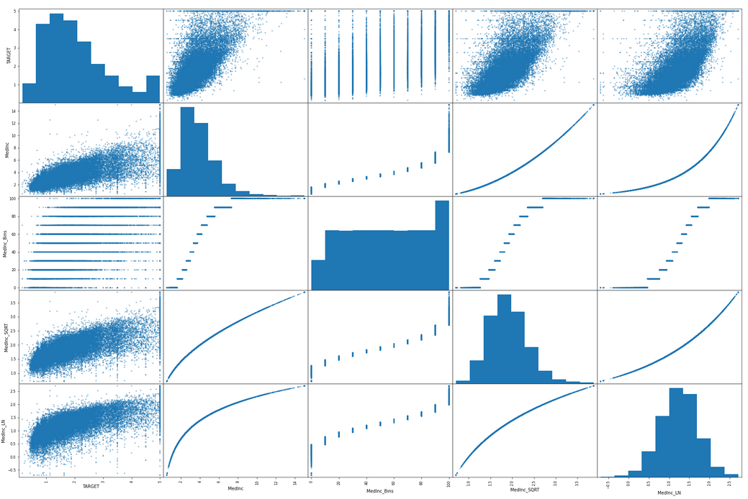
New Scatter Matrix (MedInc and Derived Features)

Slide 35
Evaluating GradientBoostingRegressor
n_estimators | Explained Variance | Mean Absolute Error | R2 Score
850 | 0.8360586 | 0.3069918 | 0.8360542
1000 | 0.8383963 | 0.3042523 | 0.8383899
... | ... | ... | ...
4000 | 0.8436616 | 0.2960558 | 0.8436533
4100 | 0.8436824 | 0.2960210 | 0.8436768
4200 | 0.8432317 | 0.2962732 | 0.8432264
4300 | 0.8436569 | 0.2964025 | 0.8436496
4400 | 0.8430246 | 0.2966966 | 0.8430169
5000 | 0.8434056 | 0.2970470 | 0.8434002
6000 | 0.8428826 | 0.2974320 | 0.8428742

Slide 36
Evaluating Multiple Regressors (Performance)
Regressor | Training Time/ Fit Time | Prediction Time/ Scoring Time | R2 Score
LinearRegression | 0.080s | 0.003s | 0.6834
RANSACRegressor | 0.192s | 0.002s | -30873.6511
KNeighborsRegressor | 0.032s | 0.231s | 0.6298
KNeighborsRegressor(n_neighbors=9, metric='manhattan') | 0.021s | 0.416s | 0.66587
SVR | 80.594s | 6.475s | -0.0138
LinearSVR | 3.374s | 0.002s | 0.2185
GaussianProcessRegressor | 64.993s | 8.530s | -3.1656
GradientBoostingRegressor (n_estimators=4100) | 138.969s (2.316 min) | 0.237s | 0.8435

Slide 37
Model Selection Using GridSearchCV
Fitting 3 folds for each of 27 candidates, totaling 81 fits
Parameters:
'loss': ['ls', 'lad', 'huber'],
'max_depth': [3, 6, 9],
'min_samples_leaf': [2, 3, 4],
'n_estimators': [4100],
'random_state': [1]
Best Parameters:
'loss': 'huber', 'max_depth': 6, 'min_samples_leaf’: 4
Best Score:
'friedman_mse': 0.84080601

Slide 38
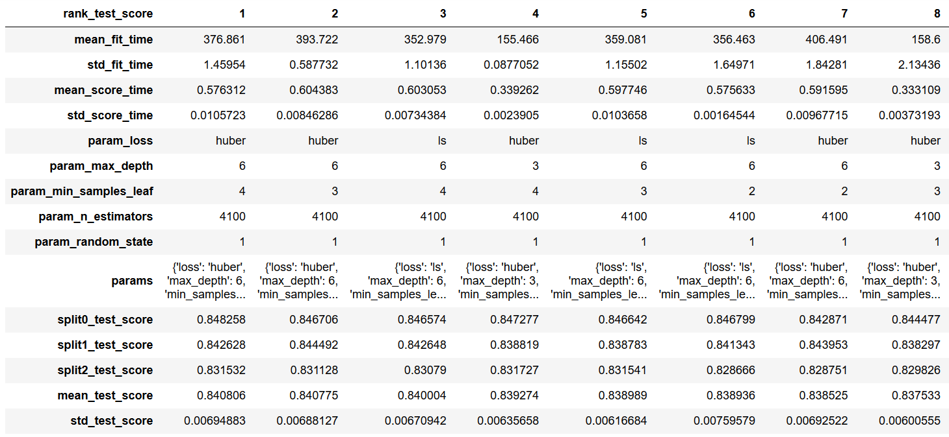
GridSearchCV Results

Slide 39
Evaluating the Final Model
GradientBoostingRegressor(alpha=0.9, criterion='friedman_mse', init=None,
learning_rate=0.1, loss='huber', max_depth=6,
max_features=None, max_leaf_nodes=None,
min_impurity_decrease=0.0, min_impurity_split=None,
min_samples_leaf=4, min_samples_split=2,
min_weight_fraction_leaf=0.0, n_estimators=4100,
n_iter_no_change=None, presort='auto', random_state=1,
subsample=1.0, tol=0.0001, validation_fraction=0.1,
verbose=0, warm_start=False)
Explained variance: 0.8478500259532393
Mean absolute error: 0.2833916740761826
R2 score: 0.8477235593652276
(Previous R2 score: 0.8436768, Authors’ R2 score = 0.8594)

Slide 40
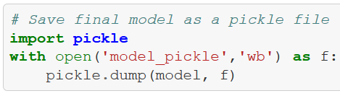
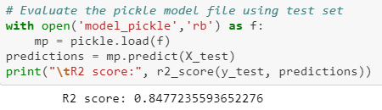
Pickle
Save the model in File using Pickle.
Load the File and Test using Test Dataset.
Predictions matched the Train Dataset.

Slide 41
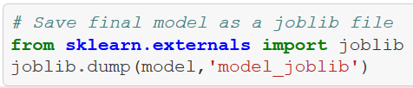
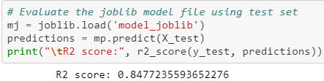
Joblib
Save the model in File using Joblib.
Load the File and Test using Test Dataset.
Predictions matched the Train Dataset.

Slide 42
What Didn’t Work
The following preprocessing steps resulted in R2 score lower than 0.76, and Mean absolute error higher than 0.29 compared to no preprocessing
StandardScaler by itself
StandardScaler with MLPRegressor
PolynomialFeatures(3), which produced 19600 total features
Applied StandardScaler, then SelectPercentile to pick 196 top features
Tried recursive feature elimination (RFE), received memory error
PolynomialFeatures(2), which produced 1176 total features
Applied StandardScaler, then SelectPercentile to pick 294 top features
Tried recursive feature elimination (RFE), received memory error

Slide 43
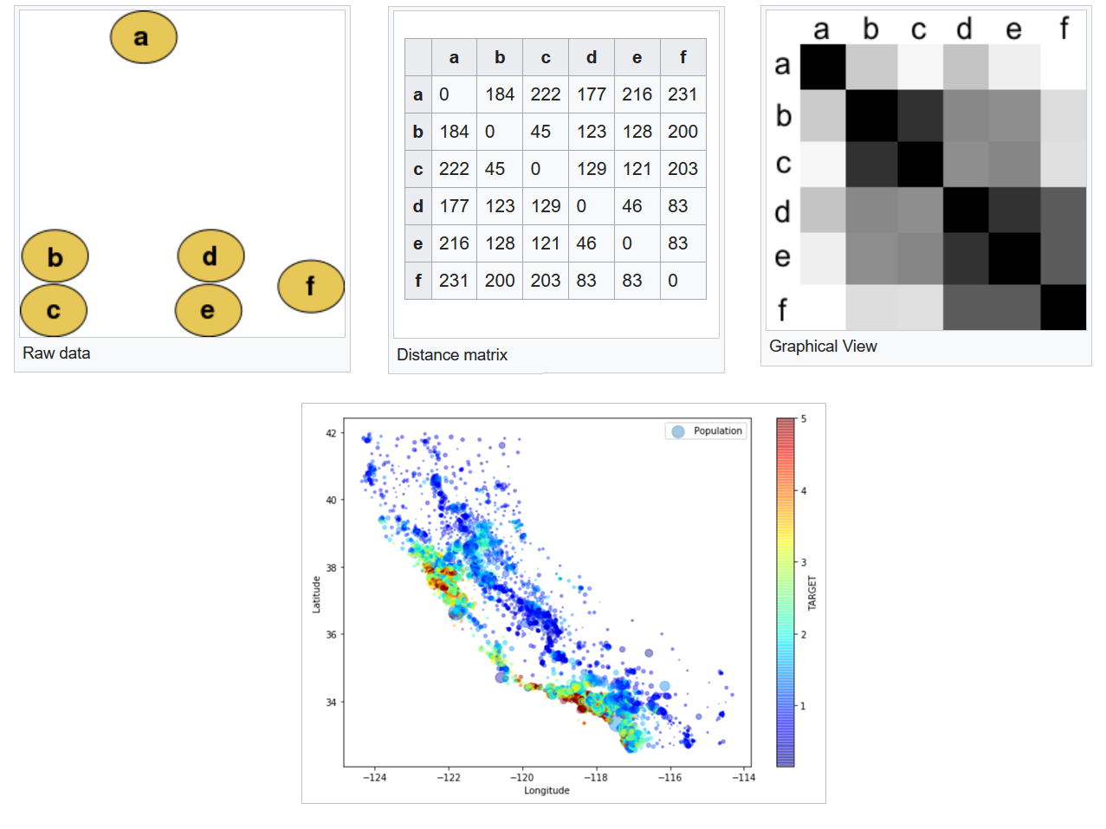
Spatial Statistics and Distance Matrix
https://en.wikipedia.org/wiki/Distance_matrix

Slide 44
Key Takeaways
Understanding why the data was collected, and how it was meant to be analyzed can save a lot of effort
Binning of feature values helps with decision tree based models
Less is more: In some cases, fewer features provide better predictions
Calculate training and prediction times for a model before testing it
Computational power is a constraint and limits the functions that can be used on larger datasets
Picking the right model is more of an art than a science

Slide 45
QUESTIONS?

Slide 46
THANK YOU!

